Slide 1
STREAMING SYSTEM CAPSTONE PROJECT
By:
Karl Eñano

Slide 2
cONTENT
1. Models
2. Model Relations
3. Authorization
4. Pages
5. Controllers
6. Notes
7. Tech used

Slide 3
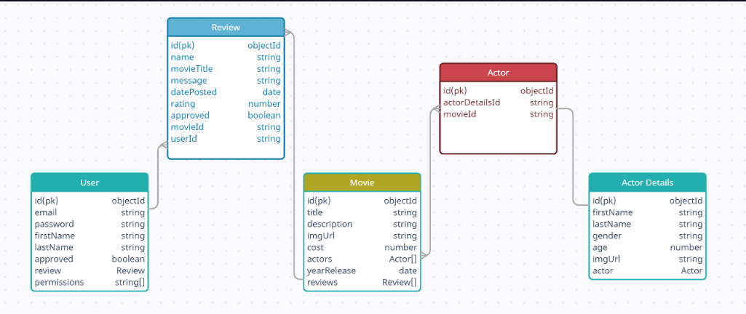
Models

Slide 4
Model relations
User can create many reviews
Movie can have many reviews
Movie can have many actors
Actor can have many movies
Actor can have one actor details

Slide 5
AUTHORIZATION
Root Admin | Admin | User | Guest
*Same as admin rules. But Account cannot be deleted | CRUD movies | View movies | View movies
 | CRUD actors | View actors | View actors
 | Search movies | Search movies | Search movies
 | Search actors | Search actors | Search actors
 | View and approve movie reviews | View add/edit own reviews | View reviews
 | Approve new admin and new user | Register/login
 | Register/login

Slide 6
Pages
LOGIN/REGISTER
HOME
ADMIN DASHBOARD - Only accessible by Admin user
MOVIE DETAILS/REVIEWS
ACTOR DETAILS

Slide 7
Controllers
user – CRUD, login/register
movies – CRUD, search
actor-details - CRUD
reviews - CRUD
actor – CRUD
Connection between movies and actor details

Slide 8
Technologies used
React - Typescript
HTML - SCSS
Redux Toolkit
MongoDB
Sonarqube
React Testing Library + Jest
Loopback 4/Testlab

Slide 9
NOTES
First user registered will be the root admin user
1 user can only write 1 review per movie

Slide 10
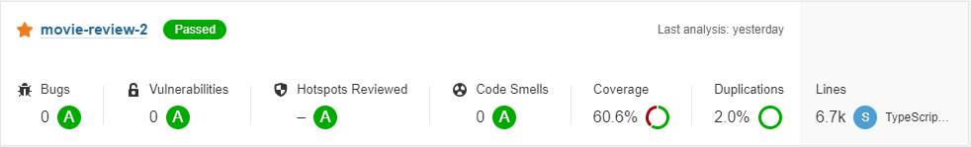
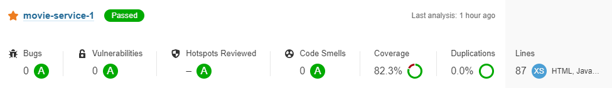
SonarQUBe TEST
FrontEnd
BackEnd

Slide 11
THANK YOU!!!

